Slide 2
THE TRUTH ABOUT ANGELS

Slide 3
Which of the Following looks like an Angel to You?

Slide 6
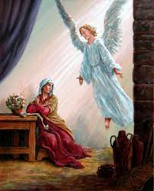

Slide 9
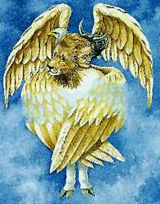

Slide 10
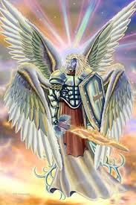

Slide 12
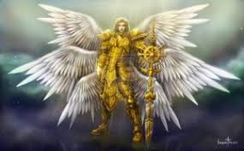

Slide 14
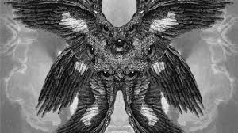

Slide 17
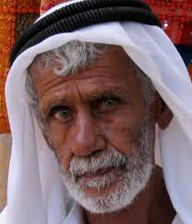

Slide 18
There is Confusion about Angels and Heavenly Beings. Angels are Heavenly/Spiritual Beings. Not all Heavenly/Spiritual Beings are Angels.

Slide 19
There is much we don’t know and can’t know because it is not revealed. Remember Deuteronomy 29:29. There are some things we can know and a few things we must know.

Slide 20
Heavenly Beings 1. Godhead - Father, Son, Holy Spirit/Ghost 2. Seraphim - used 2 times only in Isaiah - Hebrew word is used 7 times total - not called an angel 3. Cherubim - a form is used about 90 times - never called an angel

Slide 21
4. Four Living Creatures - Eze 1:5-23 5. Four Living Creatures - Rev 4:6-8 6. Twenty-four Elders - Rev 4:4 7. The angel of the LORD(67)/God(9) 8. Satan and his demons had been Heavenly beings before they fell.

Slide 22
9. Angels - a form of angel is used about 300 times including its use in the phrases “the angel of the LORD/God” - wings are never mentioned. One time an angel is flying. Revelation 14:6

